Slide 1
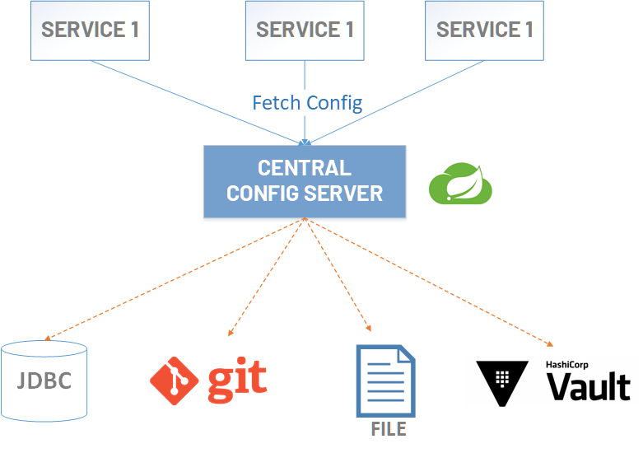



Spring Config với Github provider
www.jmaster.io/course/microservices-with-spring-cloud

